Slide 1

Interpretable ML Models for Loan Approval Systems

Slide 2
Abstract
This project develops a smart system to predict whether a loan will be approved, using past applicant data. Machine learning models such as Logistic Regression, Decision Tree, Random Forest, K-Nearest Neighbors, and SVM were used, with Random Forest giving the best accuracy. The dataset included features like income, credit history, loan amount, and employment status. To make the model's decisions easy to understand, SHAP and LIME were used for explanation. This helps banks make fair and transparent loan approval decisions.
The data was cleaned by handling missing values and encoding categorical features to prepare it for model training. Various models were evaluated using accuracy, precision, and recall to ensure reliable performance. Tools like SHAP and LIME were used to explain how the models made their decisions. This makes the system not only accurate but also transparent and trustworthy for banks to use.

Slide 3
Project Objectives
To build an interpretable loan approval system, we followed a step-by-step approach from data handling to model evaluation.Each objective supported the next, ensuring a robust and transparent solution. This helps create a reliable model with clear decision logic, boosting trust and compliance.
To collect and understand historical loan application data.
To preprocess the data by handling missing values and encoding categorical variables into a machine learning-compatible format.
To perform exploratory data analysis to identify key features that influence loan approval decisions.
To implement various machine learning algorithms such as Logistic Regression, Decision Tree, Random Forest, KNN, and SVM for training predictive models.
To evaluate and compare the performance of these models based on accuracy and reliability.
To enhance model interpretability using tools like SHAP and LIME, ensuring transparent and explainable predictions.
To develop a system that can predict loan approval status based on applicant details and provide interpretable insights into the decision process.

Slide 4
System Model Architecture
Our system follows a structured workflow from data collection to real-time loan approval prediction. It includes preprocessing, feature engineering, model training, and evaluation in a modular design.This ensures accurate, scalable, and trustworthy predictions for automated loan decisions.
Data Collection: Gather historical loan application data from diverse sources, including applicant and loan specifics.
Data Preprocessing: Clean data, manage missing values, and encode categorical data into numerical formats suitable for ML.
Feature Selection: Identify and select critical features, such as income, credit history, and employment status.
Model Training: Train multiple ML algorithms on the preprocessed data to learn prediction patterns.
Model Evaluation: Assess model performance using metrics like accuracy, precision, and recall on a test dataset.
Prediction: Utilize the best-performing model to predict approval status for new loan applications.

Slide 5
Proposed methodology
The proposed methodology involves using different machine learning algorithms to build a Model for Loan Approval Systems. After collecting and preprocessing the data, we train and compare various models to choose the best one based on accuracy and performance.
Logistic Regression
Decision Tree
Random Forest
Support Vector Machine
K-Nearest Neighbors

Slide 6
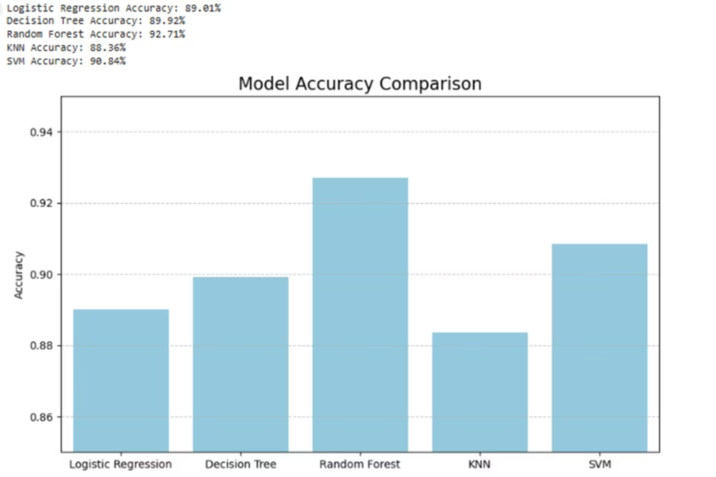
Model Accuracy Comparison

Slide 7
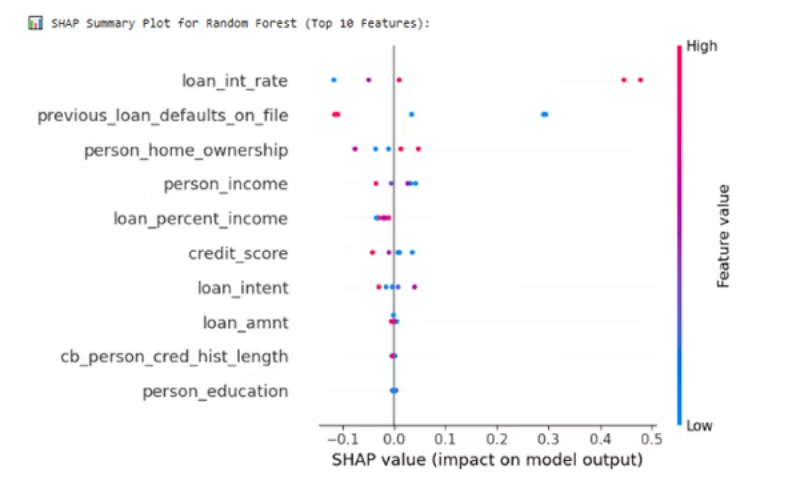
SHAP Summary Plot

Slide 8
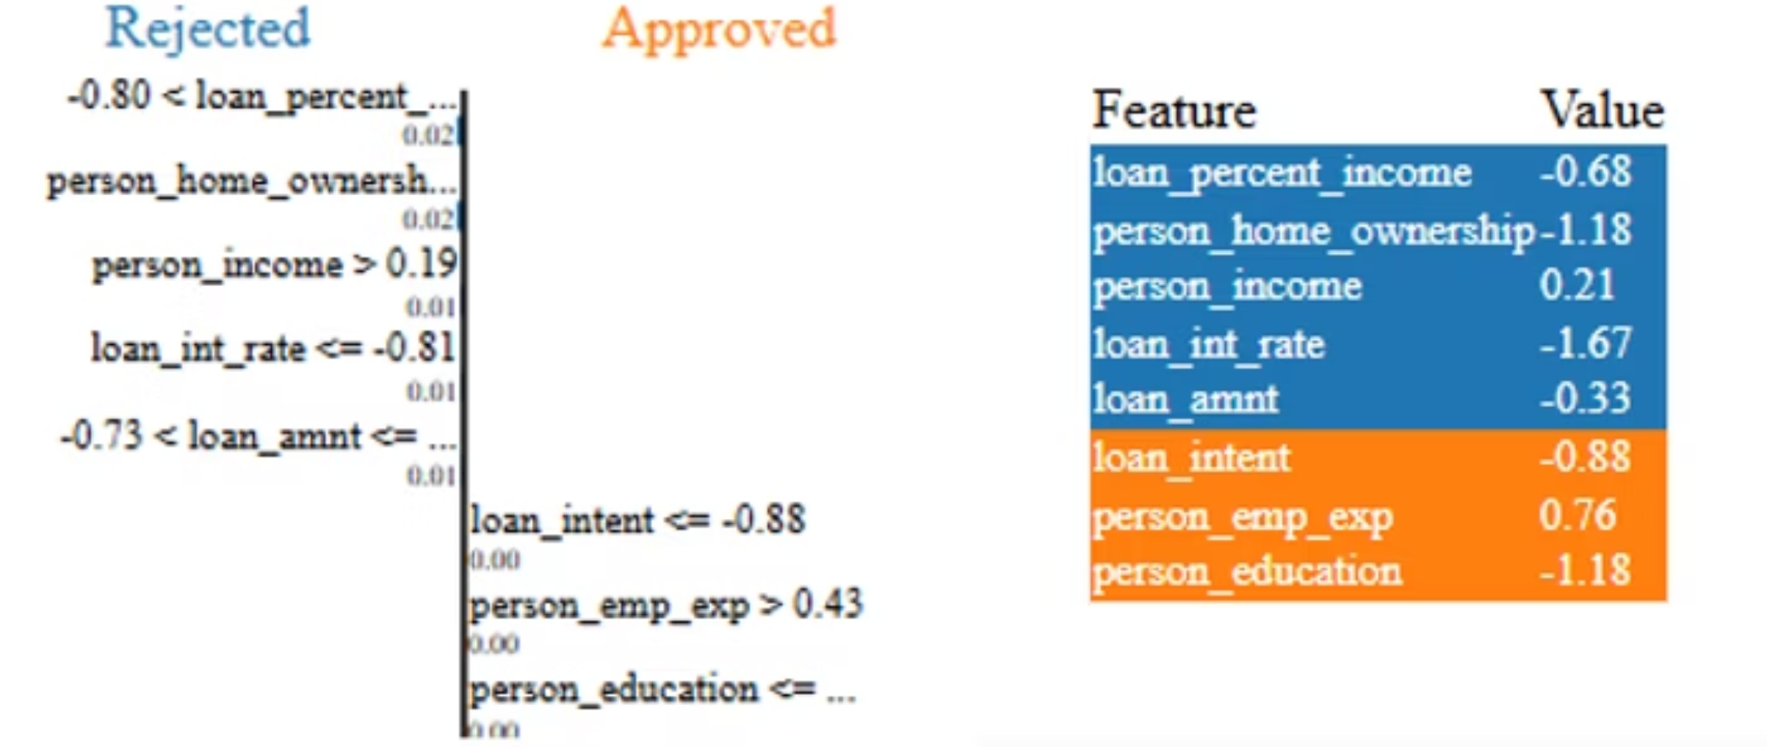
LIME Explanation

Slide 9
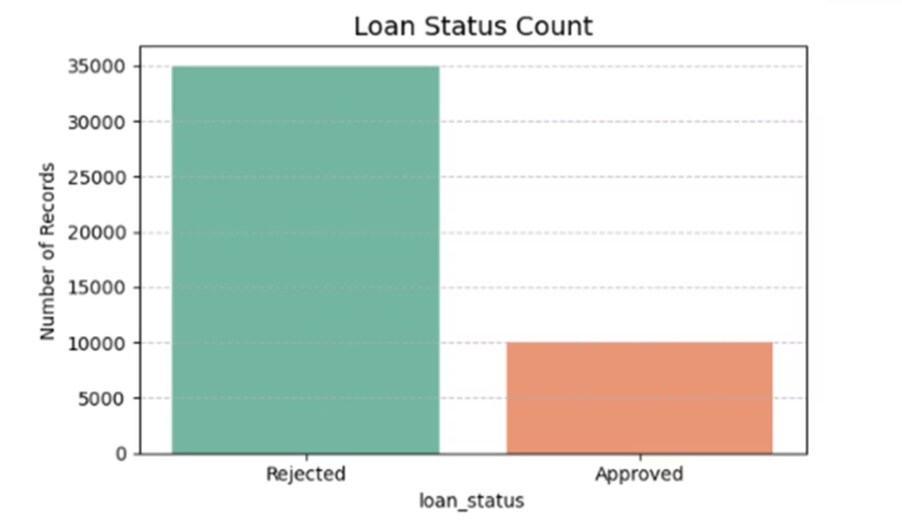
Loan Status Count

Slide 10
Future Scope
Integration of Real-time Data: Future systems can incorporate live applicant data or credit scoring services for real-time decision-making.
Incorporating More Features: Adding variables such as credit bureau scores, collateral information, and bank transaction history can improve prediction accuracy.
Deep Learning Models: Exploring deep learning approaches may further enhance performance on large-scale datasets.
Web-Based Deployment: The model can be integrated into a web application or loan approval platform for interactive use.
Bias and Fairness Analysis: Future versions can include fairness metrics to detect and mitigate any bias in predictions based on gender, income group, or geography.
Regulatory Compliance: Expanding the system to comply with legal and ethical standards in different countries for AI in lending.

Slide 11
Conclusion
In this project, we developed a machine learning-based system to predict the approval status of loan applications using historical data.Several classification models were implemented, including Logistic Regression, Decision Tree, Random Forest, SVM and KNN.After training and evaluation, the Random Forest classifier delivered the highest accuracy, making it the most suitable model for our dataset.To ensure transparency and trust in predictions, we used SHAP and LIME to interpret how the models made their decisions.These tools highlighted the most influential features, such as income, credit history, and loan amount.The project demonstrates how machine learning can support financial institutions with fair, accurate, and explainable loan approval decisions.

